Slide 1
BATTERY PARAMETER CONFIGURATION POST BATTERY SWAP ( APM30)

Slide 2
contents
-3900A Bts login criteria
-Tools (com cables) to use
-Accessing Battery parameters
-commands to enter
-Parameters to change
-Saving settings and Logging out

Slide 3
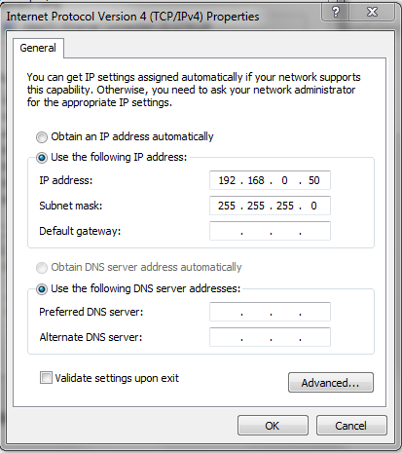
3900A BTS LOGIN Criteria
To enable web based BTS (3900A) login, we have to set the laptop IP communication as below

Slide 4
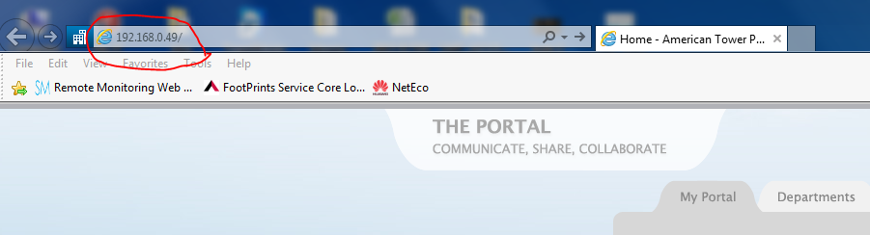
Using internet explorer/ firefox/ google chrome input login IP; 192:168:0:49
As below;

Slide 5
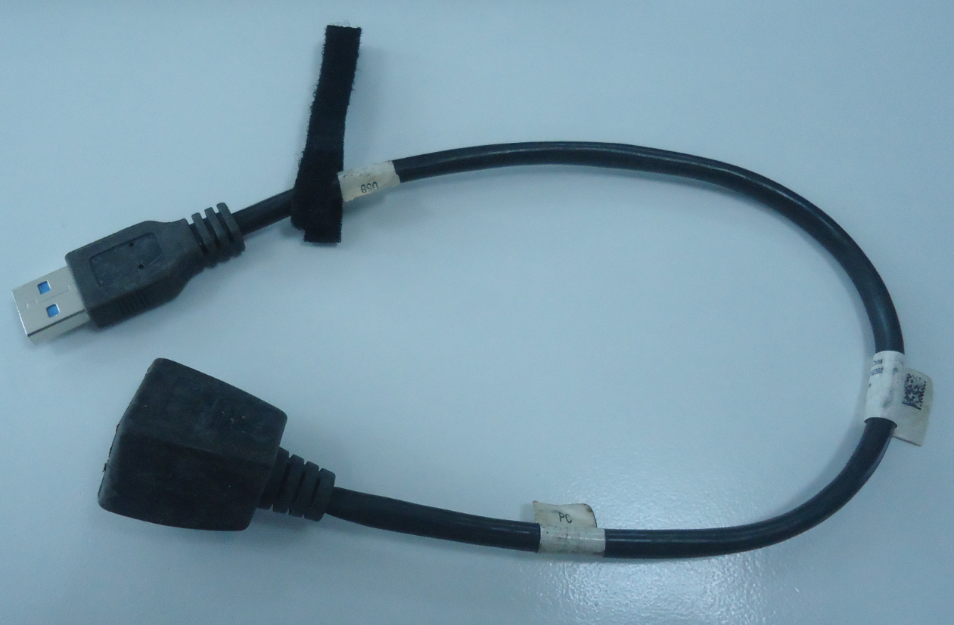
Tools used to log onto the BTS;
-USB to RJ45 cable

Slide 6
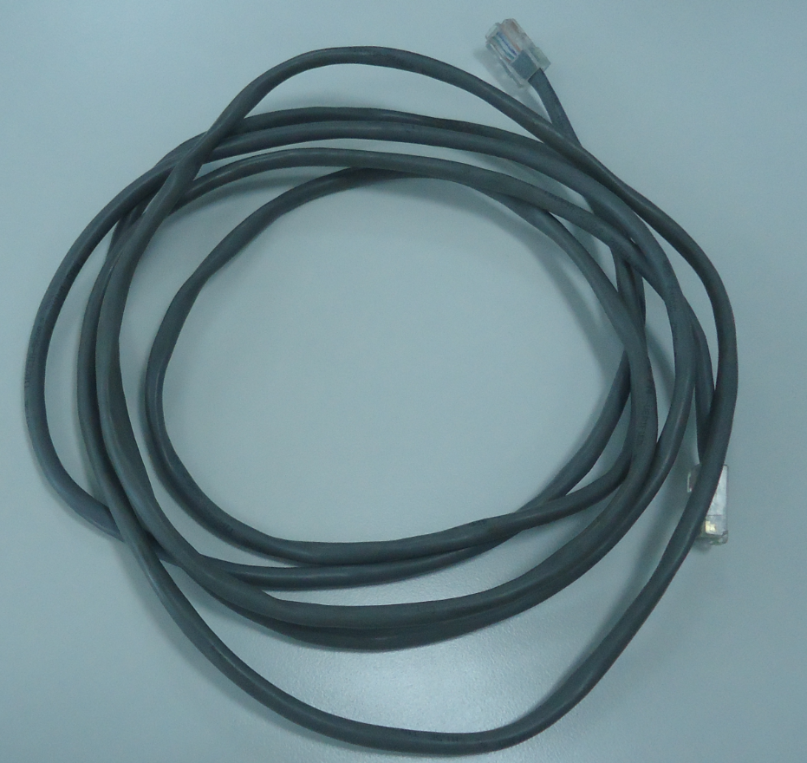
Straight cable;

Slide 7
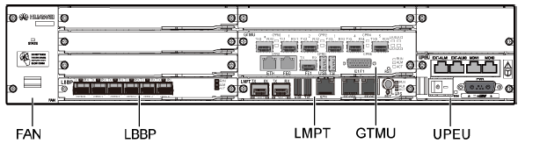
Then above cables are inter connected and fixed in the Usb port on the LMPT board, BBU 3900A unit below

Slide 8
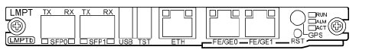
LMPT BOARD;
Use the USB port

Slide 9
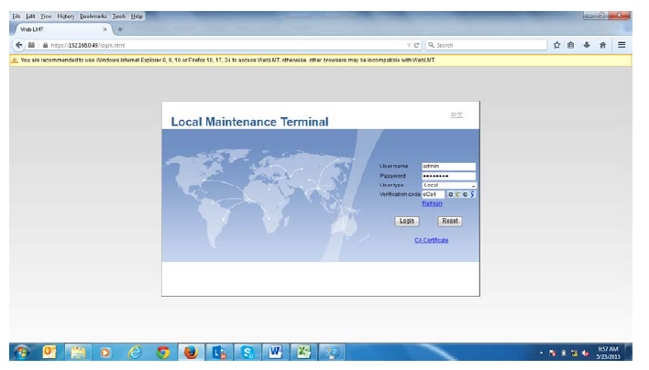
BTS login;
After entering the log-in IP as 192.168.0.49 , IE/Chrome/ Firefox will display the page below

Slide 10
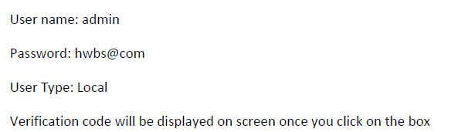
Input login Credentials below;

Slide 11
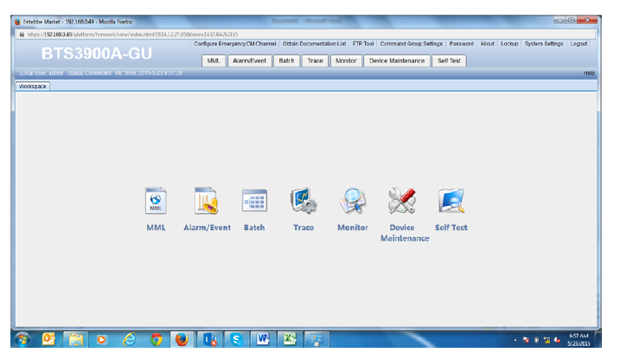
That leads you to the BTS access page below;

Slide 12
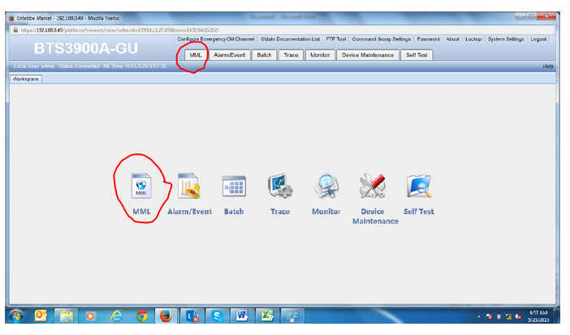
Because we are to do BTS configurations, we click on the MML Icon on the display.

Slide 13
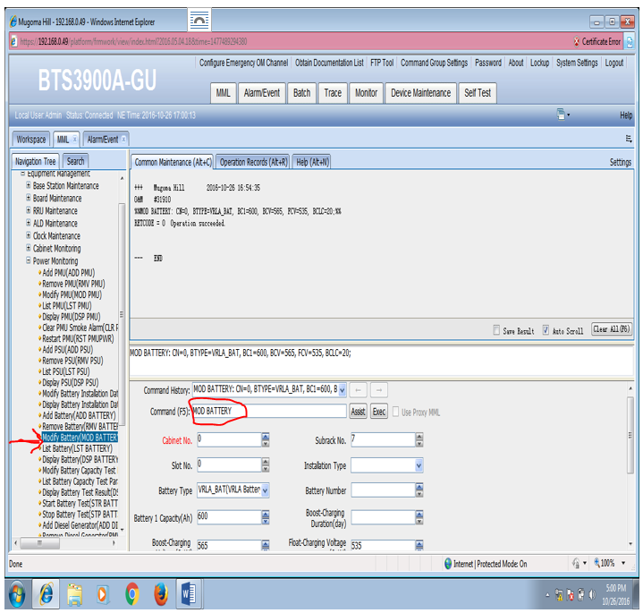
Entering commands
To access battery parameters we enter; MOD BATTERY command then execute.
Below will be displayed;

Slide 14
This gives access to all battery parameters configurable on the APM30.
Commonly configured parameters include;
-Float voltage
-boost voltage/Equalising voltage
-temperature coefficient value
-Battery charge current limit
-Battery Capacity
-Battery low voltage Disconnect
-Battery type
ETC….
NOTE; All parameters are entered without Decimal places
If say Float voltage is 53.5, it is entered as 535

Slide 15
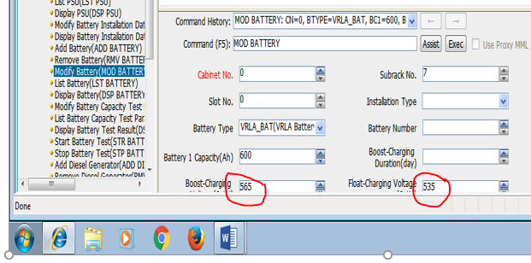
As below;

Slide 16
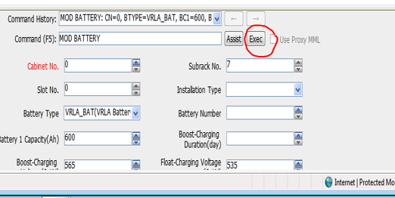
After all parameters have been entered, Click the execute button (Exec)
To save the changes.

Slide 17
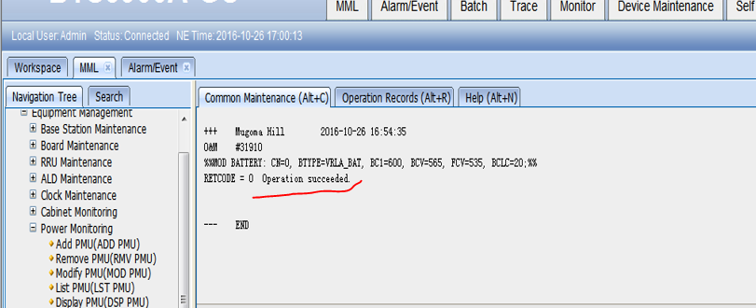
conclusion
If all the commands entered have passed and saved, it will prompt you as below
Displaying all the settings that you have entered.

